Slide 1
Module P2
Practical: SSH + Network experiments

Slide 2
Contents
Objective:
Understand SSH as a tool that can be used for remote management
Get familiar with basic networking tools commonly required in application development
Topics:
Recap
SSH
ifconfig
ping
traceroute
Student community task

Slide 3
Recap
By now we have understood:
Every computer has an IP which is used to connect to it over an IP network
A message is broken down to packets which are sent across the network and reassembled
Packets are passed from router to router on the network based on its destination address
The command line as another means of executing commands on a computer
We need some way of remotely communicating with our server machine

Slide 4
This exercise
We’re going to get a remote computer
We’re going to get access to it via a unique username/password
Like shared hosting!
We’re going to login to our remote computer and execute commands to conduct our experiments

Slide 5
Introduction to SSH
We used the terminal/command-prompt on our own computer
We can use the shell on a remote computer by logging in to that computer from our computer
One of the most common and very secure ways of accessing a remote shell is SSH
SSH is natively supported on Linux & Mac systems and is one of the best ways of server management

Slide 6
Terminal
Terminal
SSH client
SSH server
commands
commands
Computer (host)
Remote computer (another host)
imad-dev-ssh.hasura-app.io
SSH

Slide 7
Generate your user credentials...
We’ve created an IMAD console for all the practicals and experiments
Head over to https://cloud.imad.hasura.io and login
To login, you will need to create an account with github first
You will need to use your NPTEL registered email ID
Click the button on the home page to create SSH credentials
Download the chrome plugin, and use your SSH credentials to access the machine
If you’re not registered on NPTEL, you won’t be able to access the console and the common SSH computer, but you can do these experiments on your own computer

Slide 8
SSH from your computer (without the chrome plugin)
Head over to your terminal application
Run the command: ssh <username>@<hostname>
Enter your password when asked for it
On other OS
Windows (powershell/PuTTY)
Mac (terminal)
Linux (terminal/shell)

Slide 9
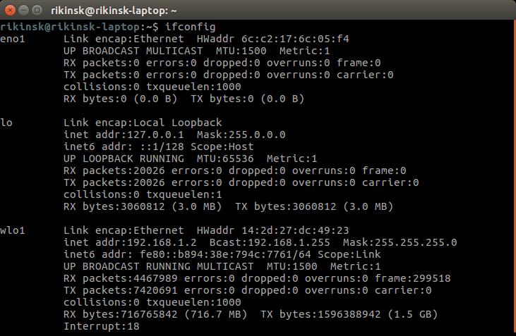
Ifconfig
The Ifconfig command displays your computer’s current network interface configuration
You should run these locally!
Windows (ipconfig)
Mac (ifconfig)
Linux (ifconfig OR ip addr)
What is an IP (IPv4)?
32 bit number to identify a computer on a network
A 32 bit number means that you can have a maximum of 2³² computers with static IPs on a network That’s less than the number of humans on earth!
So IPv6 is a new standard:
128 bit number
That’s an IP address for each atom on the earth. Actually for 100+ earths

Slide 10
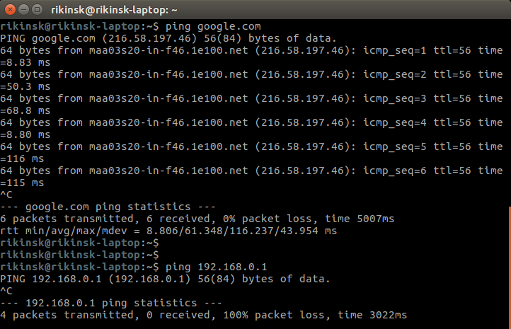
Ping
Ping command is used to send IP packets to particular server and analyze the response
RTT (Round-trip-time) is the time taken to reach a server over a network and get back a response.
RTT is a big deal because it tells us about the latency in the network between our client and server.
Technically, speed of electricity is speed of light, which means that RTT will be a minimum of = 2 * distance / speed of light. Minimum 100ms RTT from Chennai to San Francisco

Slide 11
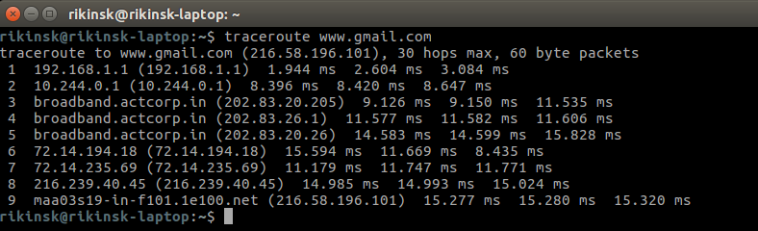
Traceroute
Traceroute command displays the route (ie: router hops) taken by a packet before reaching a server over an IP network.
You should run these locally!
Windows (tracert)
Mac (traceroute)
Linux (traceroute)

Slide 12
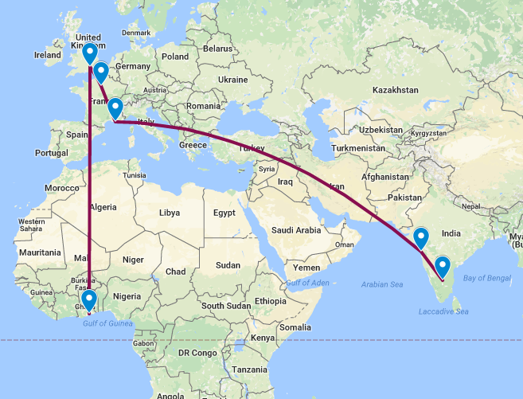
Example
Route for www.ug.edu.gh from
Bangalore.
Check out the map at:
University of Ghana

Slide 13
Student community task
Traceroute some servers from across the world and map their routes. Also try to Ping them and observe their RTTs
Share the screenshots on the forum
Try the following servers for example:
University of Basel: www.unibas.ch
Harvard University: www.harvard.edu
University of Sierra Leone: www.usl.edu.sl
University of Sydney: sydney.edu.au
University of Sao Paulo: www5.usp.br
IIT Guwahati: www.iitg.ac.in
Use an online IP location database to get the location of an IP address and put it on a map. These routes are very interesting!
Tools:
Iplocation
Google Mymaps

Slide 14
Summary
We learnt how to:
Access a remote computer and execute commands there
Use the ifconfig tool to understand the host’s network configuration
Use the ping tool to ping a remote server and get the RTT
Use the traceroute tool to see the route our packets took through the network to reach the destination

Slide 15
IMPORTANT
You do not have access to install software on the shared server! So you will not be able to get http-server and nodejs (from Modue P1) working easily on the shared server
This shared server (that we SSH into) is just to get you familiar with SSH and basic networking utilities

